Slide 1

SC1015 Project: Academic Performance Prediction
Presentation by: SC14 Grp 3
Renyu, Xu Hang, Yu Teng
Notes:
Hello. We are group 3 of SC14. This is our SC1015 mini-project titled academic performance prediction. Our group consists of Xu Hang, Yu Teng and myself, Renyu.

Slide 2
PROJECT OVERVIEW:
01
02
03
04
Motivation,
Problem Definition
Exploratory
Data
Analysis
Insights &
Outcome
Core Analysis: Machine Learning
Notes:
Firstly, we will start off with our motivation and problem definition. Secondly, we will present our Exploratory Data Analysis and some initial data-driven insights from the dataset. Subsequently, we will move to the machine learning section. And lastly, we will end off with our insights and final outcomes.

Slide 3
Motivation &
Problem Definition
01
Notes:
Let’s begin with our motivation and Problem Definition

Slide 4
Motivation
PHENOMENON
INTEREST
PREDICTION
PROGRESS
GPA is an important topic in university
University students interested
in academic performance
Predict student’s academic performance using predictors in the dataset
Provides insight for students to get better scores
Notes:
GPA is an important aspect in our university life. As students, we are interested in whether we are able to predict our performance based on certain attributes. As further motivation, this could give us better insight on how to score better.

Slide 5
Problem Definition:
Subproblem 1:
Main Problem:
Subproblem 2:
Which ML model is best
for the prediction?
What range will a student's score (low, medium or high) be given its attributes?
Which attribute influences a student’s score range the most?
Notes:
For our exact problem definition, it is : “What range will a student’s score be given its attributes?” Our project also includes two subproblems. Subproblem 1 is finding the best Machine Learning model for score prediction. And Subproblem 2 includes finding the attribute that influences a student’s score the most.

Slide 6
Problem Definition:
Main Problem:
3 Types of Score Range - Low/Medium/High
Students are placed into one of these scores
Multi-Classification Problem
Sub-problem 1:
Use of classification machine learning models
Which model performs the best
Classification Accuracy
Sub-problem 2:
Which predictor impacts the response variable the most
That predictor variable is the most impactful one
Notes:
To further elaborate, the project is about a multi-classification problem as students are placed into 3 score ranges - low , medium or high. Subproblem 1 is solved by testing different classification machine learning models and comparing performance through measures such as classification accuracy. Subproblem 2 is solved by finding the predictor variable that impacts the response variable the most.

Slide 7
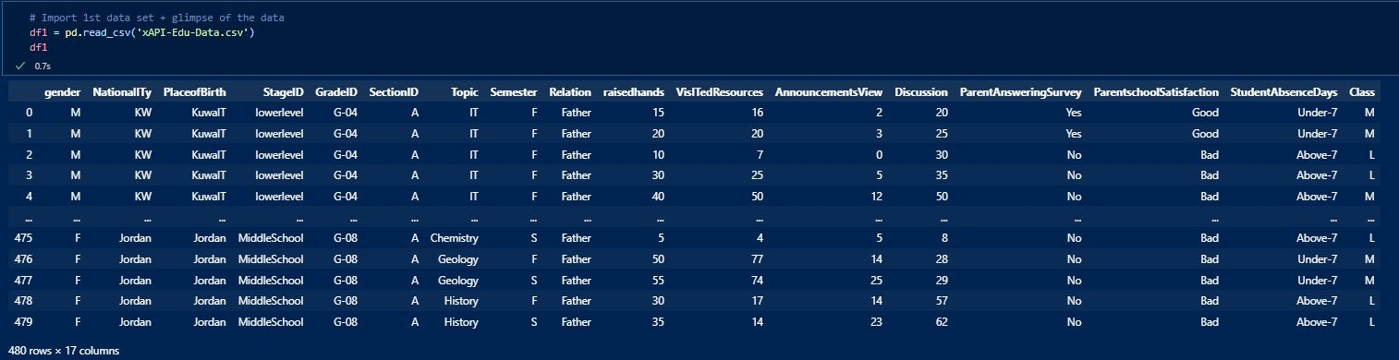
Dataset chosen:
‘Student’s Academic Performance Dataset’
Dataset is obtained from Kaggle.
https://www.kaggle.com/datasets/aljarah/xAPI-Edu-Data
Notes:
The Dataset we have chosen is obtained from Kaggle and is titled Student’s Academic Performance Dataset.

Slide 8
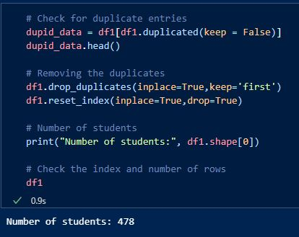
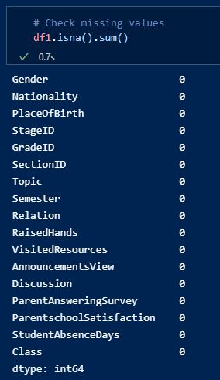
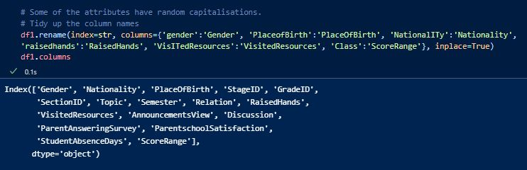
Data Preparation:
Checking and Removing Duplicates
Checking Missing Values
Rename attributes that have random capitalisations
Notes:
As part of data preparation and cleaning, we first start by checking and removing duplicates. It is unlikely for students to have the exact same 17 attributes. Therefore, 2 students' data points are flagged and removed. Secondly, we check for missing values and remove them if necessary. Thirdly, we rename some of the attributes that have random capitalisations.

Slide 9
Exploratory Data Analysis
02
Notes:
After our initial data preparation, we are now ready to begin our Exploratory Data Analysis, otherwise known as EDA.

Slide 10
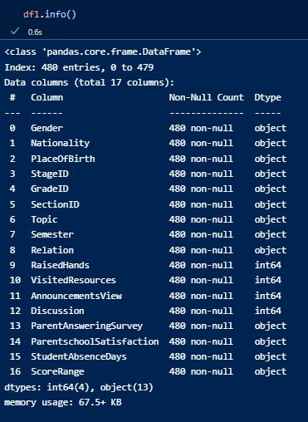
Dataset information:
480 rows (students) and 17 features (columns)
Response Variable:
Previously ‘Class’, now renamed as ‘ScoreRange’
L, M or H -> Multi-Classification Problem
16 Predictor Variables:
Consists of a mix of both numerical and categorical data types.
Grouped into 4 different types:
Demographic
Behavioral
Academic
Parental
Notes:
Our Dataset consists of 480 students as rows and 17 features as columns. Our response variable is renamed to Score Range instead of Class to prevent confusion. There are a total of 16 predictor variables initially. These predictors consist of both numerical and categorical types. We group the 16 variables into 4 different types: Namely, Demographic, Behavioural, Academic and Parental.

Slide 11
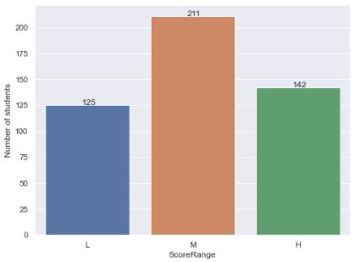
Response Variable: ‘ScoreRange’
Students are placed into L, M or H.
125 students classified as Low-Level (‘L’)
211 students classified as Medium-Level (‘M’)
142 students classified as High-Level (‘H’)
Distribution of ScoreRange looks normal.
Notes:
Here is a visualization of our response variable score range. Distribution of the score ranges look normal with most students being in the medium level.

Slide 12
Demographic Predictor Variables
Consists of 3 features:
Gender
Nationality
PlaceOfBirth
We will carry out EDA on the 3 features and determine whether they have an impact on ScoreRange.
If there is no relationship, the feature will be dropped.
Notes:
For Demographic predictor Variables, it consists of 3 features: Gender, Nationality and Place of Birth. We will carry out EDA on these 3 features and determine whether they have an impact on Score Range. If there is no relationship seen from our data, the feature will be dropped. The same procedure will be done for all predictor variables.

Slide 13
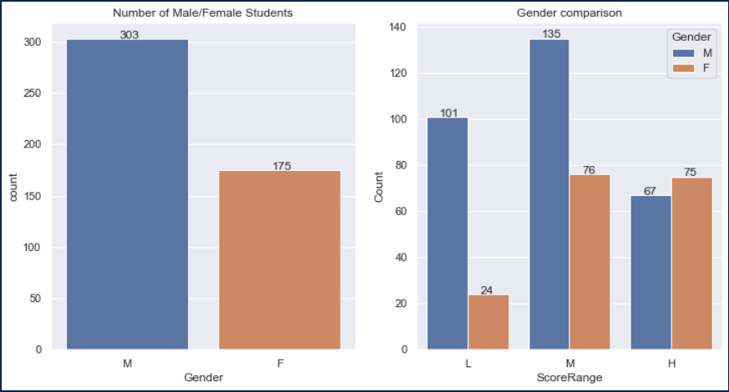
Gender
Notes:
Our visualization shows that the number of males are almost 2 times the number of females, but the females dominate the H score range.

Slide 14
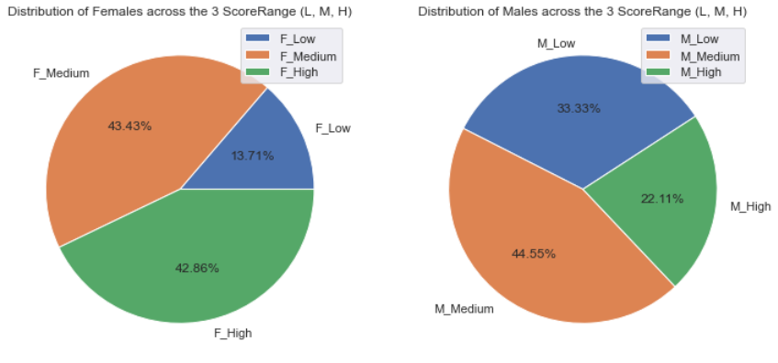
Gender
Notes:
It can be seen that a higher percentage of females score in the M and H class, therefore doing better than males.

Slide 15
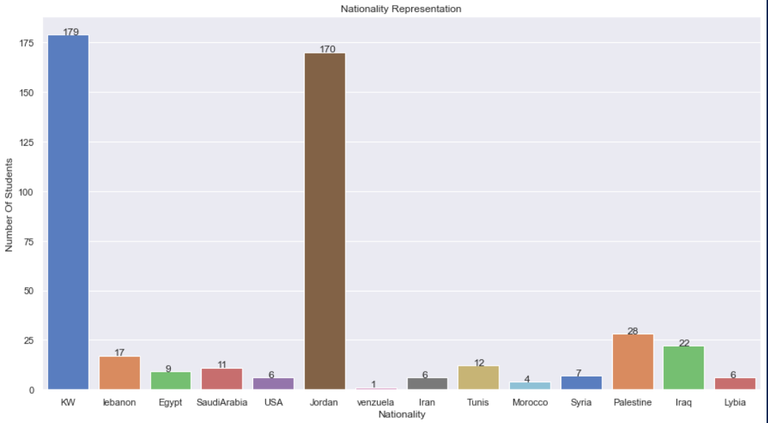
Nationality
Notes:
For Nationality, there are a total of 15 nationalities with the majority of students coming from Kuwait and Jordan.

Slide 16
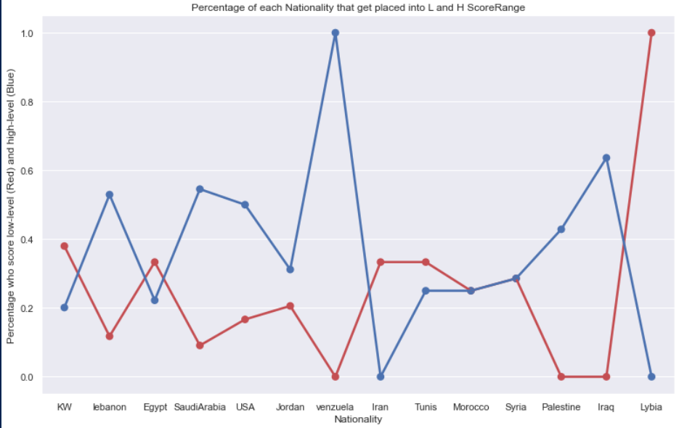
Nationality
Notes:
For this visualization, the blue shows the percentage of students of each nationality that place in H score range while the red shows those who place in L. At first glance, it may seem that some nationalities do much better than others, but this is due to the imbalances in the number of students.

Slide 17

Demographic Features Insights:
Gender analysis and visualisation shows that females performed better.
Similar to Nationality, PlaceOfBirth also has major imbalances in the distribution of students.
Therefore, only gender will be kept in the model for the following parts.
Notes:
From our data, these are some of the insights we have gained. Females performed better than males. Both Nationality and Place Of birth have extreme imbalances in the distribution of students and are therefore not reliable as predictors as we cannot establish a proper relationship between them and score range. Therefore, we will only keep Gender.

Slide 18
Behavioral Predictor Variables
Consists of 5 features:
RaisedHands
VisitedResources
AnnouncementsView
Discussion
StudentAbsenceDays
First 4 features are numerical (0 - 100)
StudentAbsenceDays is categorical (Binary)
Notes:
Moving on, Behavioural predictors consists of Raised Hands , Visited Resources, announcement views and discussion which are numerical scores, from 0 to 100, of the respective activities. Student absence days is also a behavioral predictor which is categorical.

Slide 19
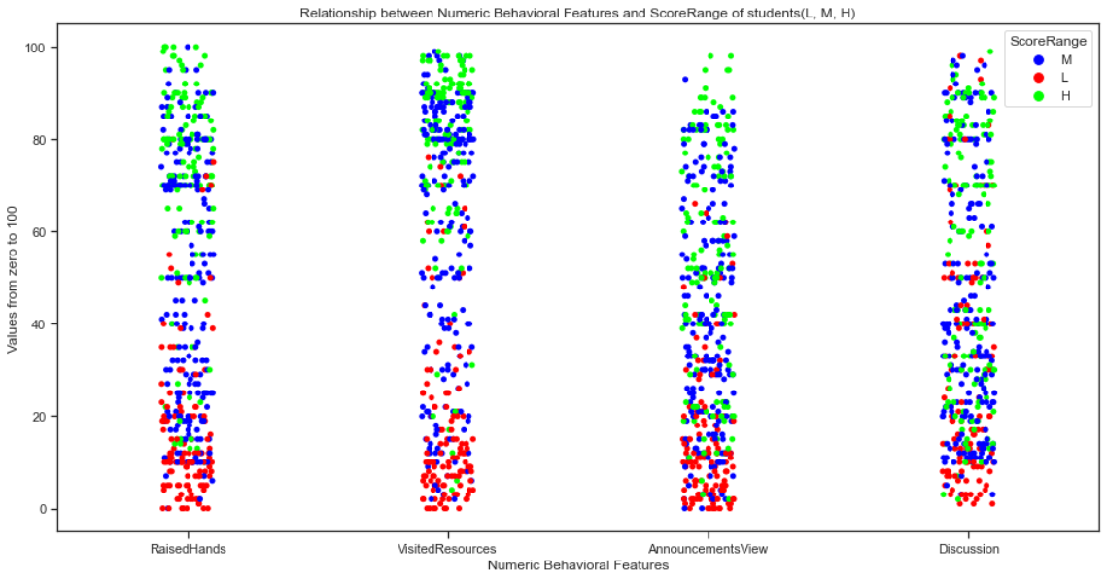
Numerical Behavioral Predictors
Notes:
This visualization shows that students who do not participate in these activities often score Low with the red points swarming at the bottom of the plots. Furthermore, it looks like most of the green points are towards the top of the plots.

Slide 20
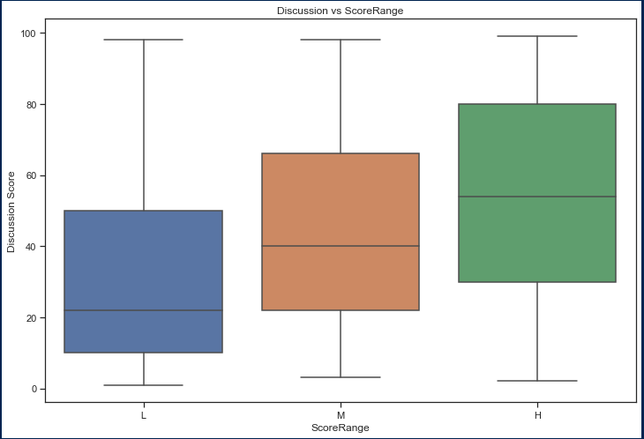
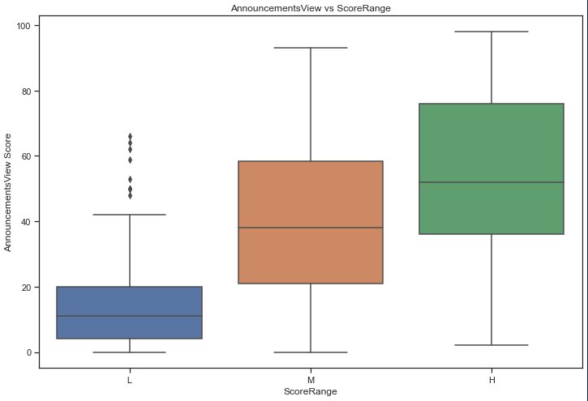
Further Analysis:
Notes:
As further analysis, these plots show that the higher the numerical scores of these features, the more likely a student will score better.

Slide 21
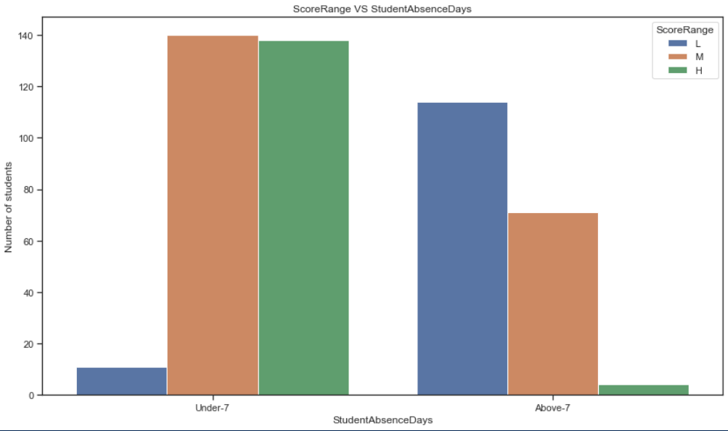
StudentAbsenceDays:
Notes:
For Student absent days, it is clear that students who are absent for more than 7 days do much worse than those who attend school more by looking at the distribution of score range.

Slide 22
Behavioral Features Insights:
All 5 Behavioral Features have a significant impact on ScoreRange
All 5 features will be kept in the model for the following parts.
Notes:
Therefore, from our insights, we have concluded that all 5 features are significant and should be kept in our model.

Slide 23
Academic Predictor Variables
Consists of 5 features:
Topic
StageID
GradeID
SectionID
Semester
All 5 are categorical features.
ScoreRange L, M and H are converted to -1, 0 and 1 temporarily for easier analysis.
Notes:
Academic Predictors consist of the following 5 features: Topic, StageID, GradeID, SectionID and Semester which are all categorical. For easier analysis, we will temporarily convert ScoreRange L, M and H to numerical values of -1, 0 and 1.

Slide 24
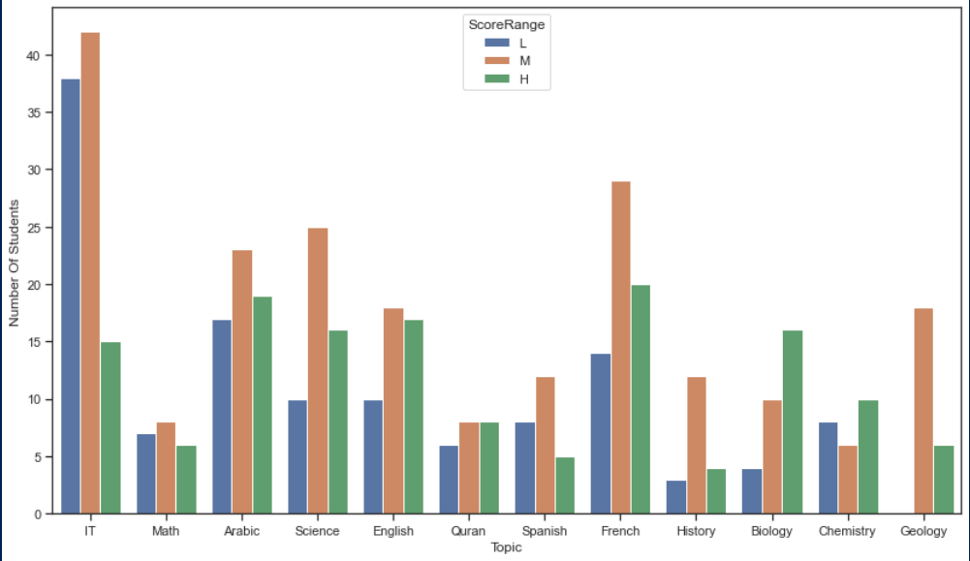
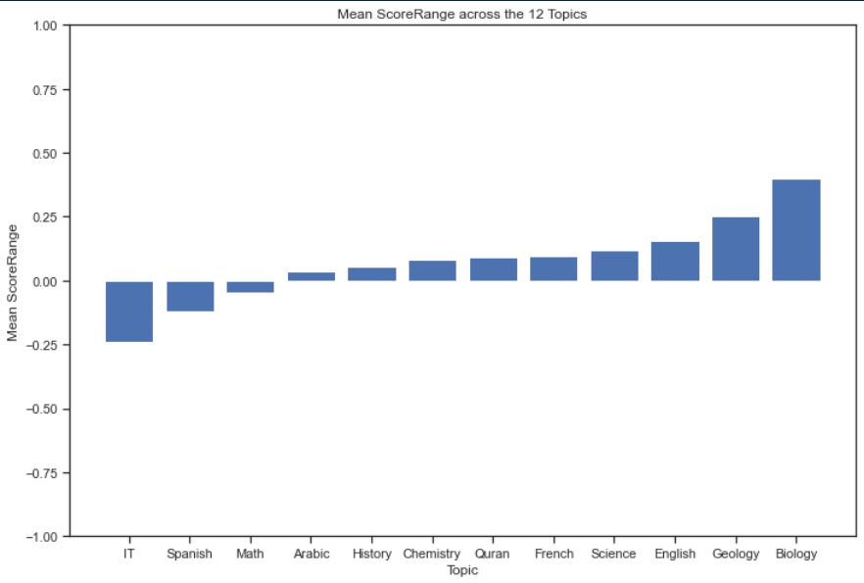
Topic
Notes:
For Topic, it can be seen from our analysis and visualization that certain topics such as Biology and Geology are much easier with more students scoring high.

Slide 25
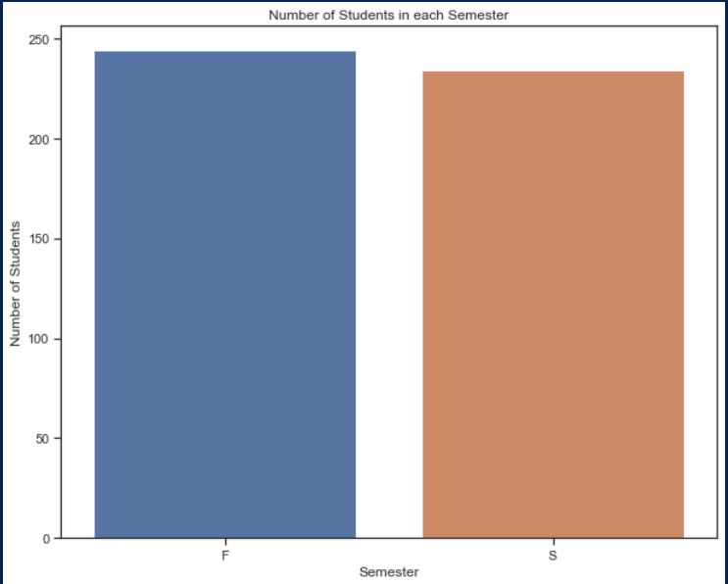
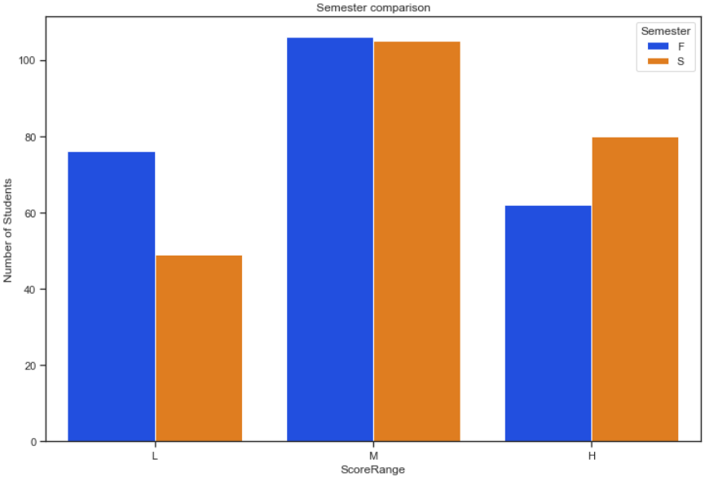
Semester
Notes:
For Semester, there are almost an equal number of students in the first and second semester. The second plot distribution shows that second semester students tend to score better.

Slide 26
Academic Features Insights:
EDA on GradeID, StageID and SectionID are carried out in the same way as Topic.
Only Topic and Semester have a significant impact on ScoreRange.
Therefore, only Topic and Semester out of the 5 features will be kept.
Notes:
The EDA on GradeID, SectionID and StageID are done in a similar way as Topic. Our notebook contains a more detailed walkthrough and information on the attributes. We found that only Topic and Semester have an impact on ScoreRange. Therefore, the other 3 features will be dropped.

Slide 27
Parental Predictor Variables
Consists of 3 features:
Relation
ParentSchoolSatisfaction
ParentAnsweringSurvey
All three features are binary categorical features.
ScoreRange L, M and H are converted to -1, 0 and 1 temporarily for easier analysis.
Notes:
Finally, for our parental features, we have three in total which are all binary categorical features. Similar to academic features, we will convert ScoreRange to numerical values for easier analysis.

Slide 28
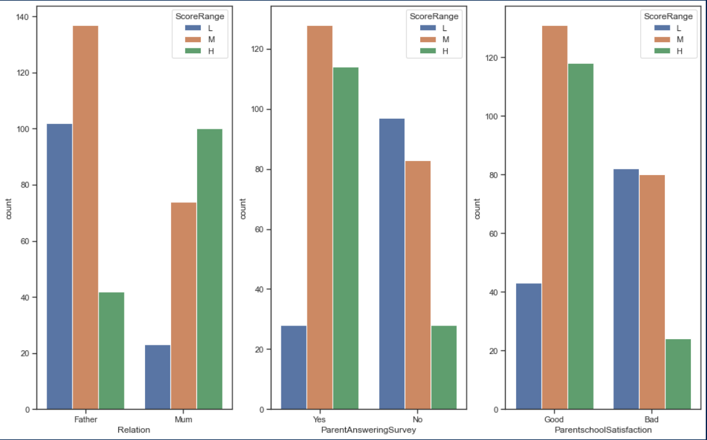
Parental Features
Notes:
Our EDA shows that all 3 factors impact ScoreRange. Here is a countplot of all 3 factors.

Slide 29
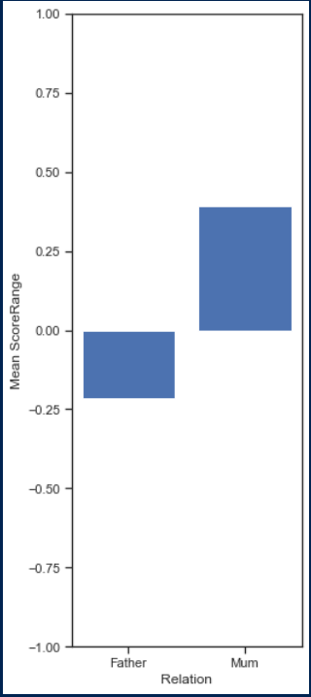
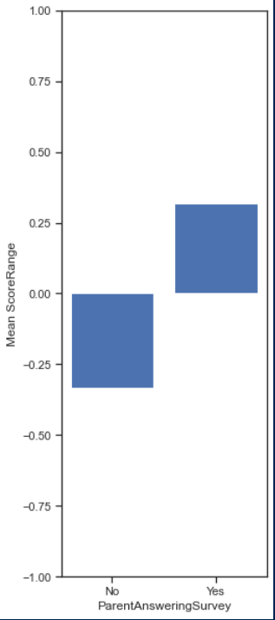
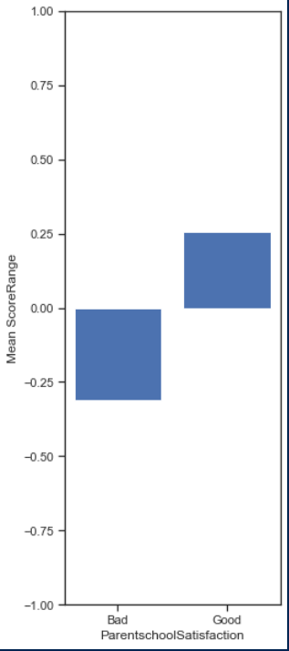
Notes:
Students with their moms in charge score higher on average. Students whose parents are more satisfied with the school or answered the survey also perform better on average.

Slide 30
Parental Features Insights:
All 3 Features have an impact on ScoreRange
Therefore all 3 features will be kept to predict ScoreRange.
Notes:
Since all 3 features affect score range to some extent, we will include them in our models later.

Slide 31
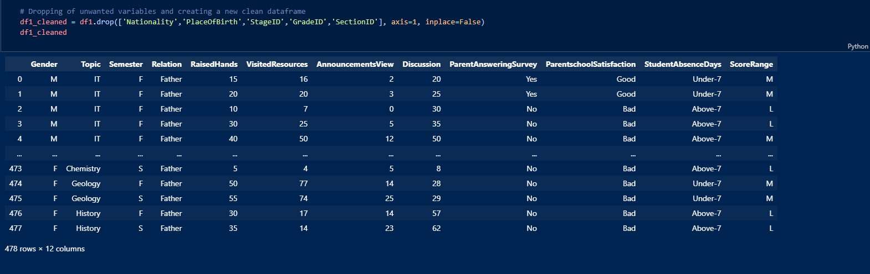
Dropping of Unwanted Predictors
Dropped 5 variables total
11 predictors variables left to use
Notes:
A total of 5 initial features are dropped leaving us with a total of 11 predictors left for our classification problem.

Slide 32
Core Analysis: Machine Learning
03
Notes:
We will now move on to the core analysis of our machine learning.

Slide 33
CREATING A MODEL
STEP 2
STEP 4
STEP 1
STEP 3
Create a transformer and associate the preprocessors with their respective columns
Split numerical and categorical columns
Apply one hot encoding on categorical columns and numerical scaling on numerical columns
Combine transformer with a classifier in a pipeline
Notes:
In order to solve our first subproblem, we decided to create a few models and then compare them to find out which is the best model. Let me explain how we create a model. Firstly, we split the columns into numerical and categorical columns, then apply one hot encoding on categorical columns and numerical scaling on numerical columns. Next, we create a transformer and associate the preprocessors with their respective columns, and then combine the transformer with a classifier in a pipeline to form a model.

Slide 34
CLASSIFIERS USED
Logistic Regression
Support Vector Machine
Decision Tree
Random Forest
K Nearest Neighbors
Notes:
The classifiers we used to create the five models are logistic regression, decision trees, random forest, support vector machine and k nearest neighbours.

Slide 35
INITIAL PROCESS
Split dataset
Optimise models
Score models
Data
Notes:
Initially, we used train test split to split the dataset into train and test datasets, then fitted the five models with the train dataset, optimised the models, and used these models to predict the test dataset. We then scored the models based on its classification accuracy on the test set. However, we realised that the optimisation values would be different every time we split the dataset differently.

Slide 36
FINAL PROCESS
Optimise models using cross validation
Score using cross validation
Data
Notes:
We then removed the splitting of the dataset and instead changed to using cross validation score to optimise and score the models, which led to more consistent results.

Slide 37
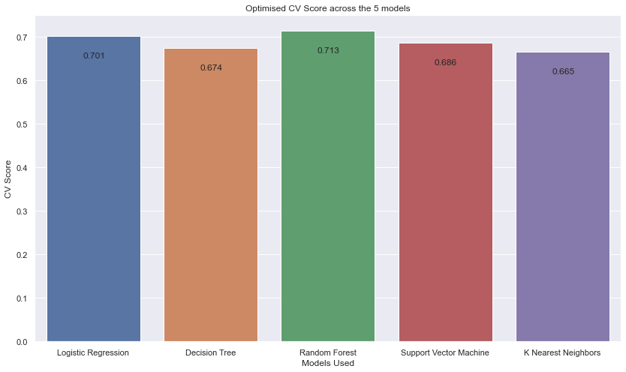
Graph comparing CV scores
Notes:
Here we see the cross-validation scores of the different models after they have been optimized. The random forest model had the highest cross validation score after optimization.

Slide 38
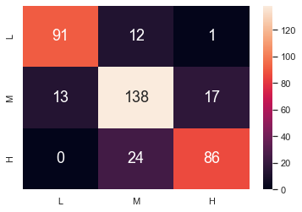
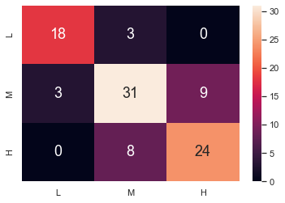
CONFUSION MATRIX
Train dataset
Test dataset
Classification accuracy:
0.8 - 0.9
Classification accuracy:
0.75 - 0.85
Notes:
Now we have the confusion matrix for a split of the dataset using the random forest model, after it has been optimized. We ran the confusion matrix a few more times for random splits of the dataset, and the classification accuracy of the train set is around 0.8 - 0.9, while the classification accuracy of the test set is around 0.75 - 0.85

Slide 39
SOLVING THE SECOND SUBPROBLEM
Score using cross validation
Drop a variable
Build a model
Data
Repeat for every variable
Notes:
To solve our second subproblem, we drop a single variable and build a model using the optimization value we obtained earlier, then calculate the cross-validation score of this model, and we repeat for all the variables, so that we can find out which variable being dropped will lead to the greatest fall in cross validation score.

Slide 40
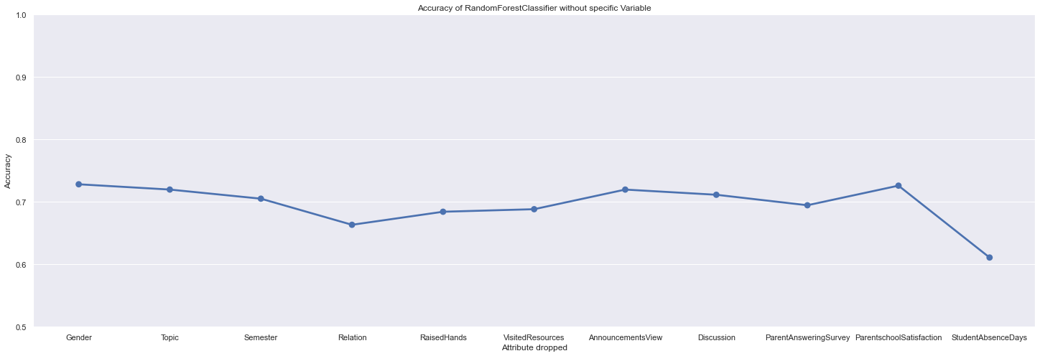
CV score after dropping a variable
Notes:
Here is the graph showing the cross-validation score after a single variable is dropped. As can be seen, dropping StudentAbsenceDays led to the model with the lowest cross validation score.

Slide 41
Insights & Outcome
04
Notes:
We will now be talking about our insights and outcome.

Slide 42

Outcomes
Subproblem 1:
Random Forest is the
best model with 0.713 CV
accuracy
Notes:
After our exploratory data analysis and machine learning, our study had several meaningful outcomes. From the study of the best models for sub-problem 1, we can see the random forest model is the best one. We have a very high prediction accuracy with the random forest model which means that we can do an accurate prediction based on given attributes most of the time and hence the model we built is reliable. We can also determine that some attributes must be important and related to a student's academic performance.

Slide 43

Outcomes
Subproblem 2:
StudentAbsenceDays is the
most influential attribute
Notes:
From the study of cross validation scores with the dropping of variables for sub-problem 2, we find that StudentAbsenceDays is obviously the most influential one. This outcome is intuitive and reasonable as the number of absence days can reflect a student’s attitude towards study.

Slide 44

Insight
· No IQ predictor -- but high accuracy
· Absence days -- attitude towards study
Notes:
Here we can find a new insight in this problem. The predictor we used did not include IQ and yet our prediction has a high accuracy. In fact, the predictor with the highest impact is the number of absence days, which shows a student’s attitude.

Slide 45
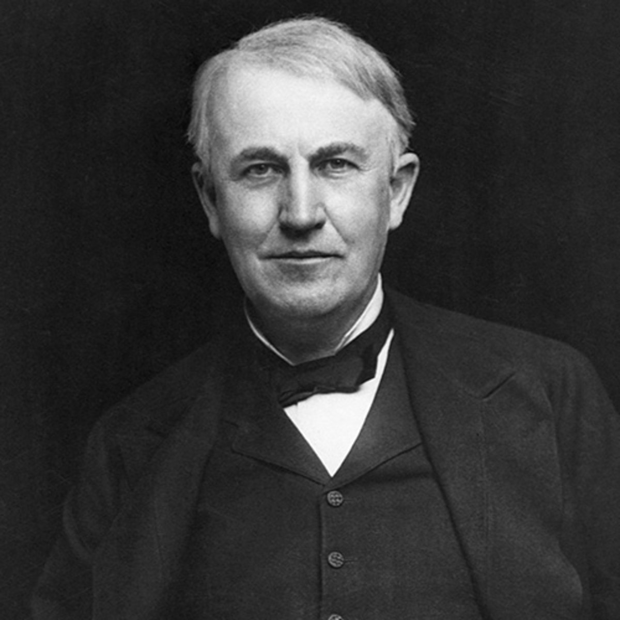
99% perspiration
Success is 1% inspiration and
Notes:
Let me leave you with a quote by Edison: ”Success is one percent inspiration and ninety nine percent perspiration”.

Slide 46
Thank
You!
Notes:
Thank you.

